Slide 1
RUSTikales Rust for beginners

Slide 2
Plan for today

Slide 3
Plan for today
Recap

Slide 4
Plan for today
Recap
Lifetimes

Slide 5
Plan for today
Recap
Lifetimes
Functions

Slide 6
Recap

Slide 7
Recap
loop {} to create an infinite loop
while condition {} to create a conditional loop
for elem in collection {} to create an iterator over a collection

Slide 8
Recap
loop {} to create an infinite loop
while condition {} to create a conditional loop
for elem in collection {} to create an iterator over a collection
Ownership-Model
Every value in Rust has exactly one owner
Values are dropped (memory is freed) when the owner is dropped
Ownership-Conflicts are resolved by moving ownership, if we can‘t copy the value

Slide 9
Recap
loop {} to create an infinite loop
while condition {} to create a conditional loop
for elem in collection {} to create an iterator over a collection
Ownership-Model
References
Way to borrow data without moving or copying it
Can be immutable or mutable

Slide 10
Recap
loop {} to create an infinite loop
while condition {} to create a conditional loop
for elem in collection {} to create an iterator over a collection
Ownership-Model
References
Borrow Checker
zero mutable references to a value → infinite immutable references allowed
one mutable reference to a value → zero immutable references allowed
two+ mutable references to a value → forbidden, compiler error

Slide 11
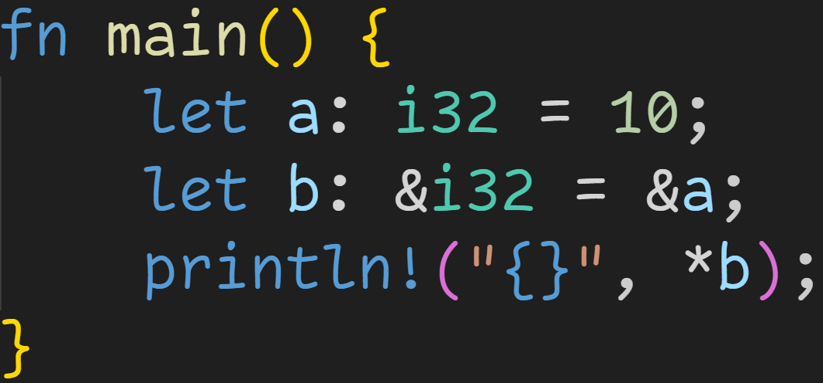
Recap

Slide 12
Recap
Immutable borrow

Slide 13
Recap
Type: Reference to i32

Slide 14
Recap
Dereference b to get the original value

Slide 15
Recap
Addr | Stack

Slide 16
Recap
Addr | Stack
0x4000 | a | 10

Slide 17
Recap
Addr | Stack
0x4000 | a | 10
0x4004 | b | 0x4000

Slide 18
Recap
Addr | Stack
0x4000 | a | 10
0x4004 | b | 0x4000
Read the value at that memory location

Slide 19

Recap
Addr | Stack
0x4000 | a | 10
0x4004 | b | 0x4000

Slide 20
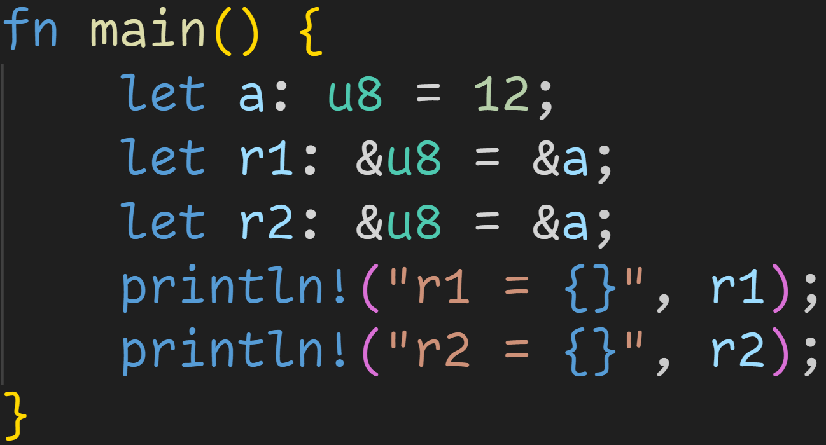
Recap

Slide 21
Recap
Immutable borrows

Slide 22
Recap
Implicit dereference

Slide 23
Recap
Addr | Stack

Slide 24
Recap
Addr | Stack
0x1000 | a | 12

Slide 25
Recap
Addr | Stack
0x1000 | a | 12
0x1001 | r1 | 0x1000

Slide 26
Recap
Addr | Stack
0x1000 | a | 12
0x1001 | r1 | 0x1000
0x1009 | r2 | 0x1000

Slide 27
Recap
Addr | Stack
0x1000 | a | 12
0x1001 | r1 | 0x1000
0x1009 | r2 | 0x1000
println! automatically dereferences for us

Slide 28
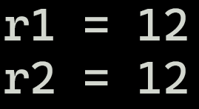
Recap
Addr | Stack
0x1000 | a | 12
0x1001 | r1 | 0x1000
0x1009 | r2 | 0x1000
println! automatically dereferences for us

Slide 29
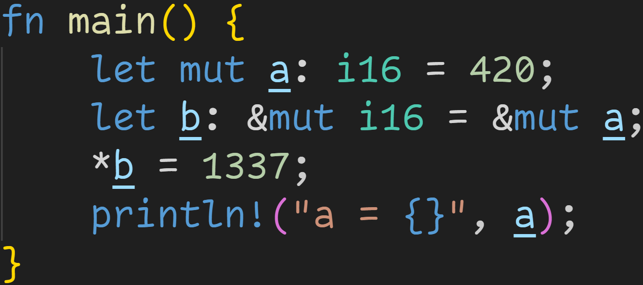
Recap

Slide 30
Recap
Mutable borrow

Slide 31
Recap
Mutable borrow only possible when value itself is mutable
Mutable borrow

Slide 32
Recap
Addr | Stack

Slide 33
Recap
Addr | Stack
0x8000 | a | 420

Slide 34
Recap
Addr | Stack
0x8000 | a | 420
0x8002 | b | 0x8000

Slide 35
Recap
Addr | Stack
0x8000 | a | 420
0x8002 | b | 0x8000
Write 1337 into location pointed to by b

Slide 36
Recap
Addr | Stack
0x8000 | a | 420
0x8002 | b | 0x8000
Write 1337 into location pointed to by b

Slide 37
Recap
Addr | Stack
0x8000 | a | 1337
0x8002 | b | 0x8000
Write 1337 into location pointed to by b

Slide 38

Recap
Addr | Stack
0x8000 | a | 1337
0x8002 | b | 0x8000

Slide 39
Lifetimes

Slide 40
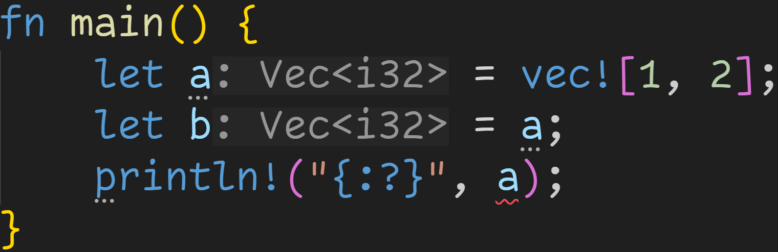
Lifetimes
The problem: Memory safety

Slide 41
Lifetimes
The problem: Memory safety
Compiler moves the value of a into b

Slide 42
Lifetimes
The problem: Memory safety
a
content
length | 2
capacity | 4
heap
0xabc0 | 1
0xabc4 | 2
... | ...

Slide 43
Lifetimes
The problem: Memory safety
a
content
length | 2
capacity | 4
heap
0xabc0 | 1
0xabc4 | 2
... | ...
b
content
length | 2
capacity | 4

Slide 44
Lifetimes
The problem: Memory safety
a
content
length | 2
capacity | 4
heap
0xabc0 | 1
0xabc4 | 2
... | ...
b
content
length | 2
capacity | 4
Ownership violation!
Memory would be freed twice at the end!

Slide 45
Lifetimes
The problem: Memory safety
a
content | ???
length | ???
capacity | ???
heap
0xabc0 | 1
0xabc4 | 2
... | ...
b
content
length | 2
capacity | 4
Solution:
→ Move a into b
→ Invalidate a

Slide 46
Lifetimes
The problem: Memory safety
a
content | ???
length | ???
capacity | ???
Error: a is not initialized, can‘t use it – It was moved

Slide 47
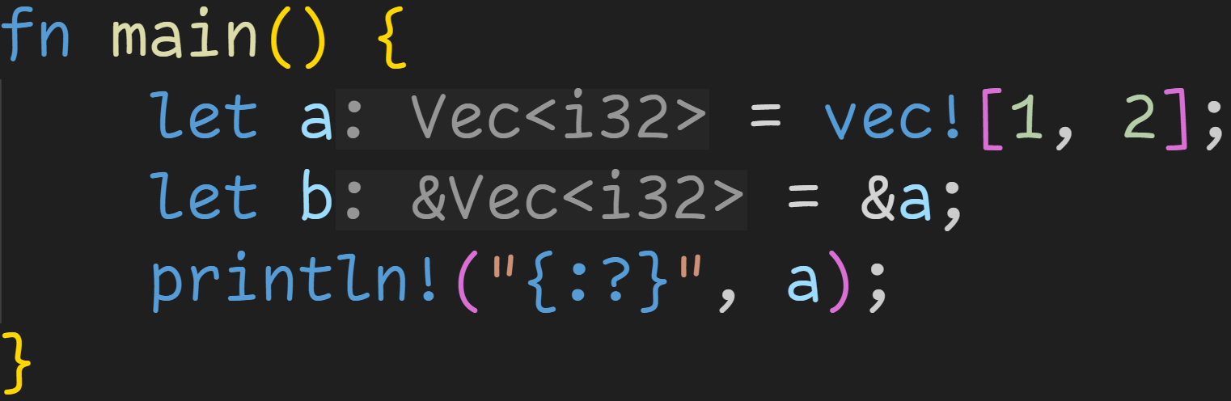
Lifetimes
The solution: References

Slide 48
Lifetimes
The solution: References
b
pointer
a
content
length | 2
capacity | 4
heap
0xabc0 | 1
0xabc4 | 2
... | ...

Slide 49
Lifetimes
The solution: References
b
pointer
a
content
length | 2
capacity | 4
heap
0xabc0 | 1
0xabc4 | 2
... | ...
No ownership violation:
a still owns the memory on the heap
b does not own a, it just points to it

Slide 50
Lifetimes
The solution: References
b
pointer
a
content
length | 2
capacity | 4
heap
0xabc0 | 1
0xabc4 | 2
... | ...
a still valid here, no data was moved

Slide 51
Lifetimes
References in its simplest form are memory addresses
can point to any memory, to the stack, to the heap

Slide 52
Lifetimes
References in its simplest form are memory addresses
can point to any memory, to the stack, to the heap
Pointers are easy to mishandle
dangling pointers
race conditions

Slide 53
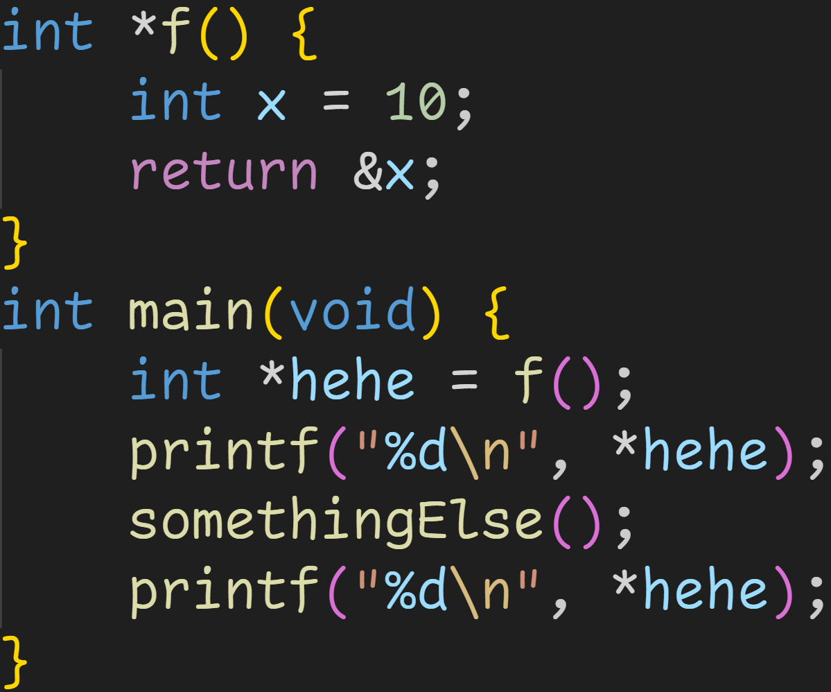
Lifetimes
3/3

Slide 54
Lifetimes
3/3
What does this C code print?

Slide 55
Lifetimes
3/3
What does this C code print?
→ We can‘t know.
→ The first printf() prints 10
→ somethingElse() may overwrite the memory the pointer is pointing to

Slide 56
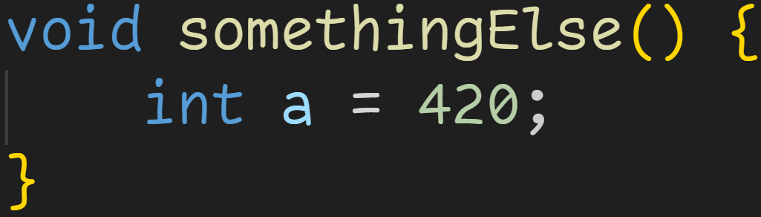
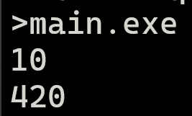
Lifetimes
3/3
What does this C code print?
→ We can‘t know.
→ The first printf() prints 10
→ somethingElse() may overwrite the memory the pointer is pointing to

Slide 57
Lifetimes
References in its simplest form are memory addresses
Pointers are easy to mishandle
More is required to make them memory safe, and fit for Rust‘s goals

Slide 58
Lifetimes
References in its simplest form are memory addresses
Pointers are easy to mishandle
More is required to make them memory safe, and fit for Rust‘s goals
The compiler needs to analyze when and how references are valid
Part One: Borrow Checker
Part Two: Lifetimes

Slide 59
Lifetimes
Lifetimes are a construct of the compiler
Technically everything is a construct of the compiler

Slide 60
Lifetimes
Lifetimes are a construct of the compiler
Technically everything is a construct of the compiler
Lifetimes allow the compiler to analyze and optimize the final code
Lifetimes don‘t get into the final executable
Memory Safety guarantees

Slide 61
Lifetimes
A lifetime describes two things

Slide 62
Lifetimes
A lifetime describes two things
A region of code where the reference must be valid
A region of memory where the reference may point into

Slide 63
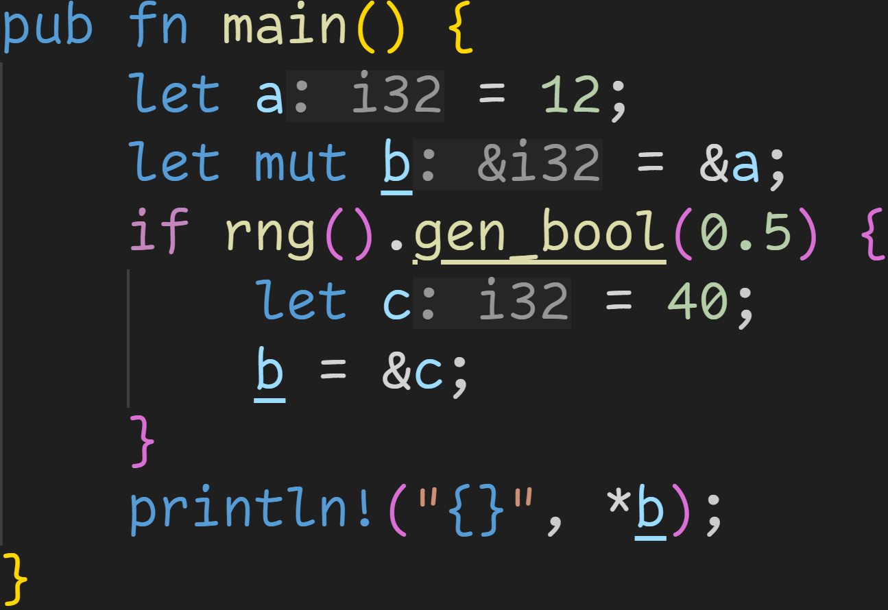
Lifetimes

Slide 64
Lifetimes
region of code where &a must be valid

Slide 65
Lifetimes
region of code where &a must be valid
region of code where &c must be valid

Slide 66
Lifetimes
region of code where &a must be valid
ref | value
b
var | value
a | 12
c | 40
we use b here

Slide 67
Lifetimes
region of code where &a must be valid
ref | value
b
var | value
a | 12
c | 40
we use b here
Depending on RNG, b may point to either a or c
→ When we *b, both memory locations must be alive

Slide 68
Lifetimes
ref | value
b
var | value
a | 12
c | 40
c is alive here and then dropped
region of code where &c must be valid

Slide 69
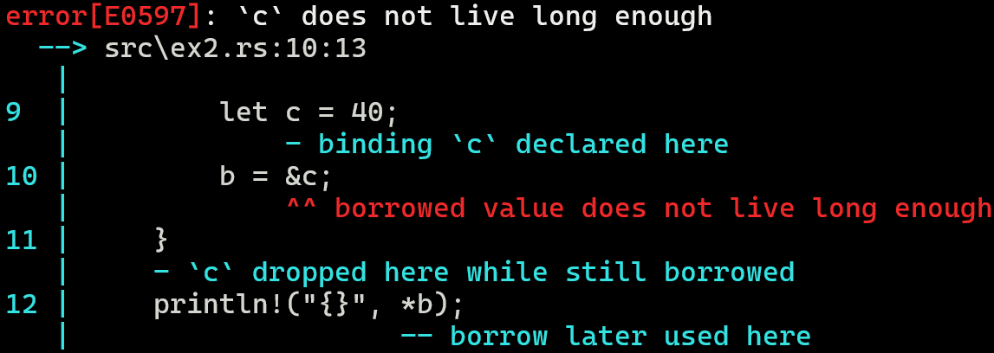

Lifetimes

Slide 70
Lifetimes
A lifetime describes two things
A region of code where the reference must be valid
A region of memory where the original value must live in
The regions of code don‘t have to be contiguous

Slide 71
Lifetimes
A lifetime describes two things
A region of code where the reference must be valid
A region of memory where the original value must live in
The regions of code don‘t have to be contiguous
References must only be valid between uses

Slide 72
Lifetimes
A lifetime describes two things
A region of code where the reference must be valid
A region of memory where the original value must live in
The regions of code don‘t have to be contiguous
References must only be valid between uses
Non-Lexical Lifetimes
The compiler is very good at figuring out the shortest required lifetimes for references

Slide 73
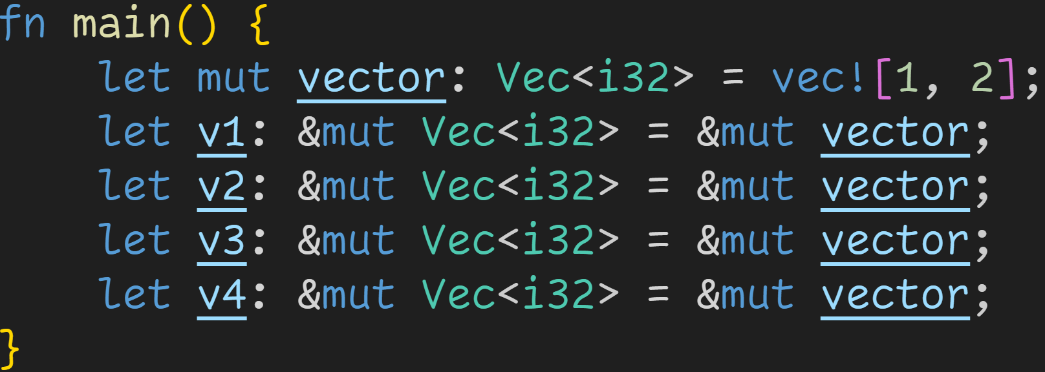
Lifetimes

Slide 74
Lifetimes
v1 used here
v2 used here
v3 used here
v4 used here

Slide 75
Lifetimes
v1 used here
v2 used here
v3 used here
v4 used here
→ No overlap, everything is fine

Slide 76
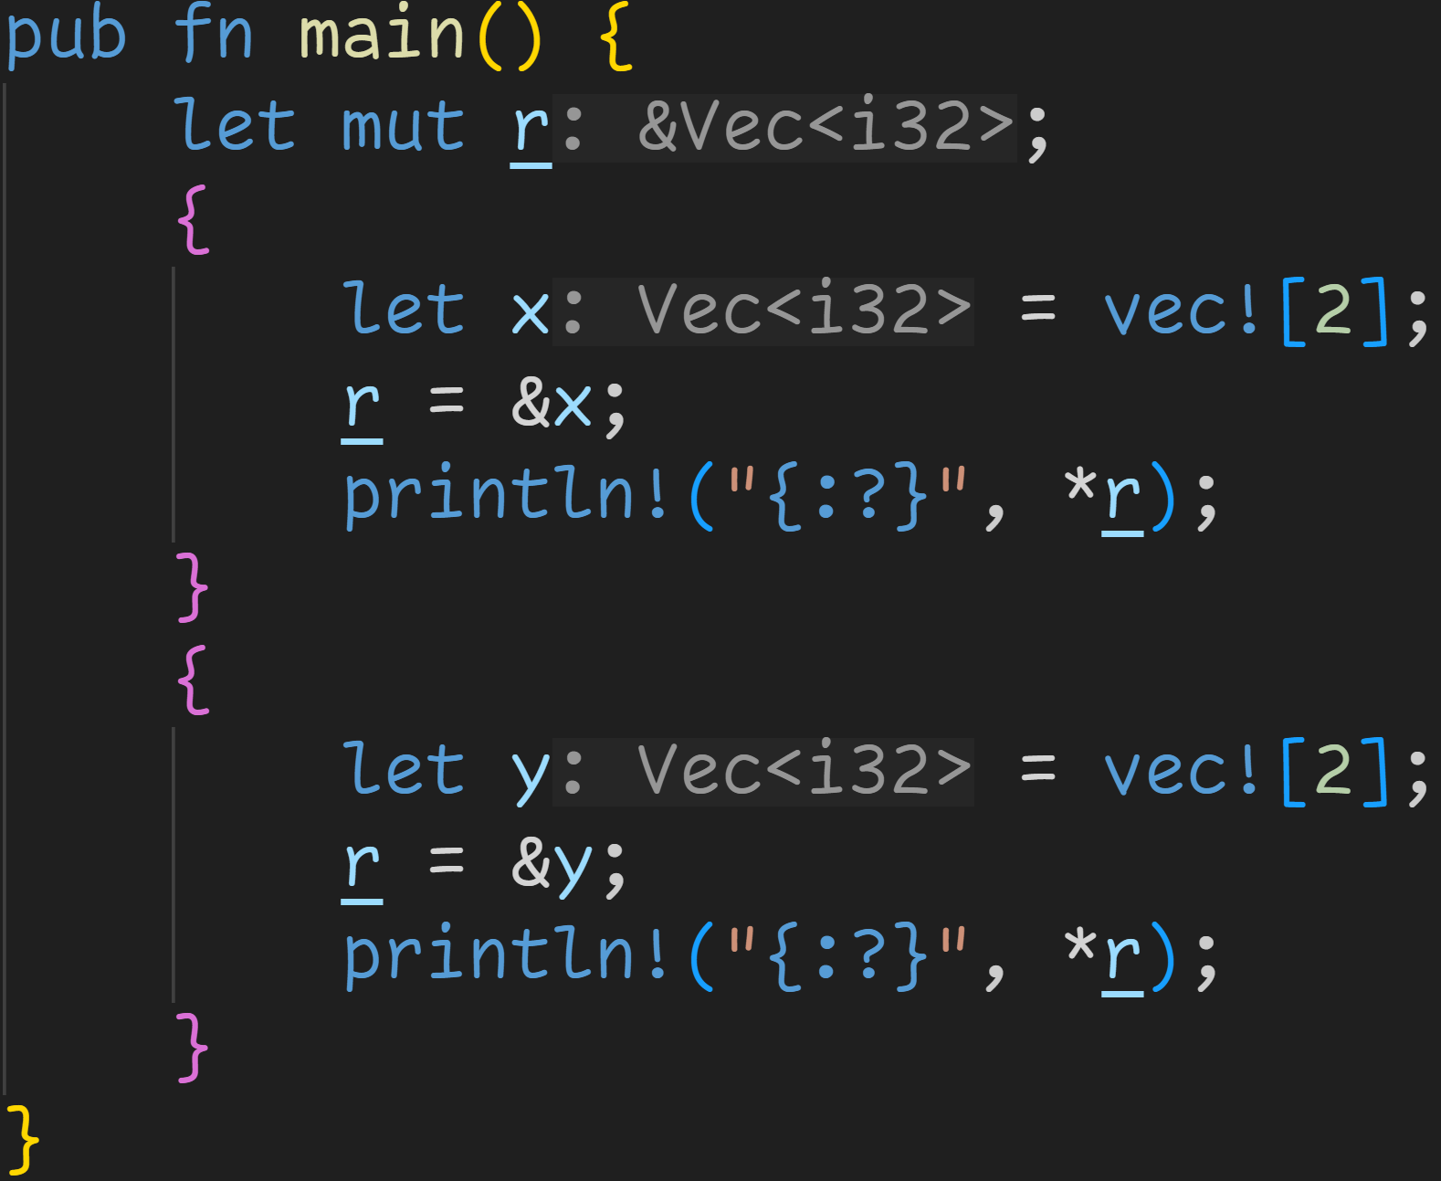
Lifetimes

Slide 77
Lifetimes
region of code where &x must be valid
region of code where &y must be valid

Slide 78
Lifetimes
region of code where &x must be valid
We don‘t care about this section → r refers to a dropped value, but we don‘t use r
region of code where &y must be valid

Slide 79
Lifetimes
Lifetimes get complicated when we cross the function border
But as we don‘t know what functions are, we will cover that later :^)

Slide 80
Lifetimes
Lifetimes get complicated when we cross the function border
But as we don‘t know what functions are, we will cover that later :^)
Extra details about lifetimes will be introduced when needed

Slide 81
Functions

Slide 82
Functions
Programming languages come with many control flow structures

Slide 83
Functions
Programming languages come with many control flow structures
if
loops, break, continue

Slide 84
Functions
Programming languages come with many control flow structures
Functions are another way of controlling your code

Slide 85
Functions
Programming languages come with many control flow structures
Functions are another way of controlling your code
Functions allow us to isolate pieces of logic, instead of writing one big blob of code

Slide 86
Functions
Programming languages come with many control flow structures
Functions are another way of controlling your code
Functions allow us to isolate pieces of logic, instead of writing one big blob of code
We can write a function that calculates prime numbers
We can write a function that checks if a vector contains a number
We can write a function that checks if a vector contains a prime number

Slide 87
Functions
Programming languages come with many control flow structures
Functions are another way of controlling your code
Functions allow us to isolate pieces of logic, instead of writing one big blob of code
Functions in programming are almost* identical to mathematical functions
We take in some inputs (called parameters)
We do something with those inputs
We return some output (called return value)

Slide 88
Functions
Programming languages come with many control flow structures
Functions are another way of controlling your code
Functions allow us to isolate pieces of logic, instead of writing one big blob of code
Functions in programming are almost* identical to mathematical functions
We take in some inputs (called parameters)
We do something with those inputs
We return some output (called return value)
Functions are declared using the keyword fn
The most important one – fn main() – always needs to be declared

Slide 89
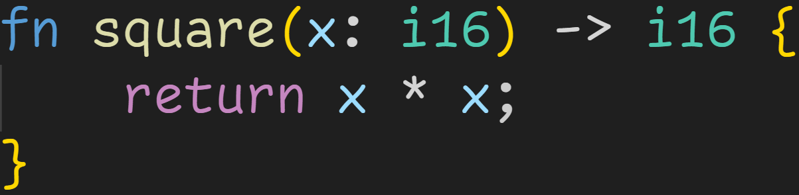
Functions

Slide 90
Functions
Parameters

Slide 91
Functions
Parameters
Return Type (optional)

Slide 92
Functions
Parameters
Return Type (optional)
Function body

Slide 93
Functions
Parameters
Return Type (optional)
return keyword → we return the provided value (here x * x) from the function

Slide 94
Functions
Function name
Parameters
Return Type (optional)
return keyword → we return the provided value (here x * x) from the function

Slide 95
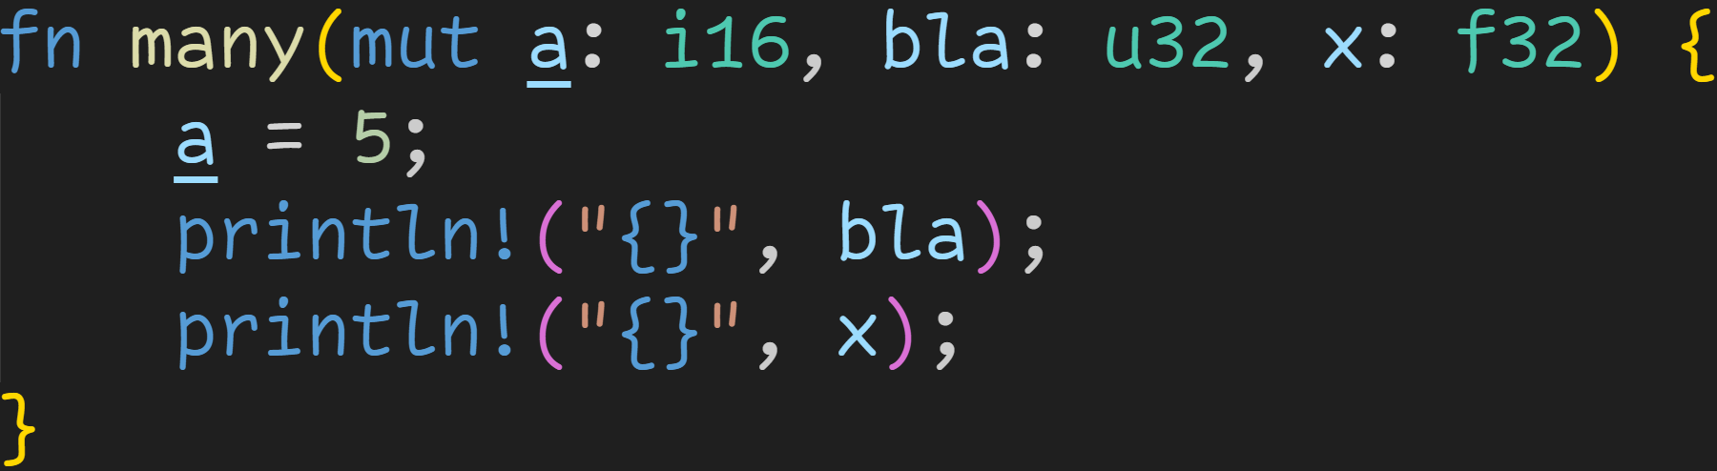
Functions

Slide 96
Functions
Parameters are comma-separated name-type pairs

Slide 97
Functions
Parameters are treated like normal variables:
→ Mutability rules apply → Ownership rules apply → Borrow Checker rules apply

Slide 98
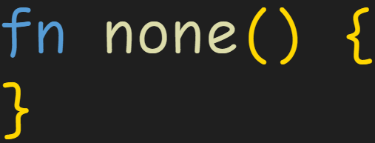
Functions
Functions can also take zero parameters

Slide 99
Intermission - Floating Point
Integers are good, your computer loves them, but they have their limits

Slide 100
Intermission - Floating Point
Integers are good, your computer loves them, but they have their limits
We can only represent whole numbers
We can‘t represent big numbers

Slide 101
Intermission - Floating Point
Integers are good, your computer loves them, but they have their limits
For those situations, we have to use floating point numbers

Slide 102
Intermission - Floating Point
Integers are good, your computer loves them, but they have their limits
For those situations, we have to use floating point numbers
Rust has f32 and f64

Slide 103
Intermission - Floating Point
Integers are good, your computer loves them, but they have their limits
For those situations, we have to use floating point numbers
Rust has f32 and f64
As with integers, the number specifies the size in bits
f32 → 32bit float
f64 → 64bit float

Slide 104
Intermission - Floating Point
Integers are good, your computer loves them, but they have their limits
For those situations, we have to use floating point numbers
Rust has f32 and f64
As with integers, the number specifies the size in bits
Floating Point numbers are numbers in Scientific Notation (in base 2)
Example in base 10: 5e7 = 5*10^7 = 50.000.000

Slide 105
Intermission - Floating Point
Integers are good, your computer loves them, but they have their limits
For those situations, we have to use floating point numbers
Rust has f32 and f64
As with integers, the number specifies the size in bits
Floating Point numbers are numbers in Scientific Notation (in base 2)
Example in base 10: 5e7 = 5*10^7 = 50.000.000
Numbers are made of two numbers:
Mantissa → Number before the e, here 5
Exponent → Number after the e, here 7

Slide 106
Intermission - Floating Point
Floating Point numbers are numbers in Scientific Notation (in base 2)
Example in base 10: 5e7 = 5*10^7 = 50.000.000
Numbers are made of two numbers:
Mantissa → Number before the e, here 5
Exponent → Number after the e, here 7
Floats get a few bits for the mantissa, and a few for the exponent
f32 → 1 bit sign, 8 bits exponent , 23 bits mantissa
f64 → 1 bit sign, 11 bits exponent , 52 bits mantissa

Slide 107
Intermission - Floating Point
Floating Point numbers are numbers in Scientific Notation (in base 2)
Floats get a few bits for the mantissa, and a few for the exponent
This way, we can represent fractions
f32 → ~8 decimal digits
f64 → ~16 decimal digits

Slide 108
Intermission - Floating Point
Floating Point numbers are numbers in Scientific Notation (in base 2)
Floats get a few bits for the mantissa, and a few for the exponent
This way, we can represent fractions
f32 → ~8 decimal digits
f64 → ~16 decimal digits
This way, we can represent big numbers
f32 → MAX = 3.4*10^38 ← 38 zeroes! We‘d need u128 to represent that!
f64 → MAX = 1.8*10^308 ← 308 zeroes! We‘d need u1024 to represent that!

Slide 109
Intermission - Floating Point
There‘s a problem → Limited precision

Slide 110
Intermission - Floating Point
There‘s a problem → Limited precision
We can only store 7 decimal digits at all times in the mantissa → At big exponents, we skip numbers → 5.400000000*10^30 + 1 == 5.400000000*10^30

Slide 111
Intermission - Floating Point
There‘s a problem → Limited precision
We can only store 7 decimal digits at all times in the mantissa → At big exponents, we skip numbers → 5.400000000*10^30 + 1 == 5.400000000*10^30
We only have limited space for numbers → Just like we can‘t represent 1/3 in base 10, we can‘t represent some numbers in base 2

Slide 112
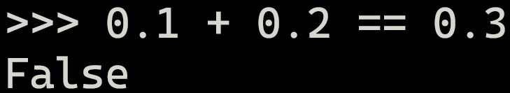
Intermission - Floating Point
There‘s a problem → Limited precision
We can only store 7 decimal digits at all times in the mantissa → At big exponents, we skip numbers → 5.400000000*10^30 + 1 == 5.400000000*10^30
We only have limited space for numbers → Just like we can‘t represent 1/3 in base 10, we can‘t represent some numbers in base 2

Slide 113
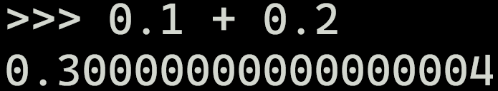
Intermission - Floating Point
There‘s a problem → Limited precision
We can only store 7 decimal digits at all times in the mantissa → At big exponents, we skip numbers → 5.400000000*10^30 + 1 == 5.400000000*10^30
We only have limited space for numbers → Just like we can‘t represent 1/3 in base 10, we can‘t represent some numbers in base 2

Slide 114
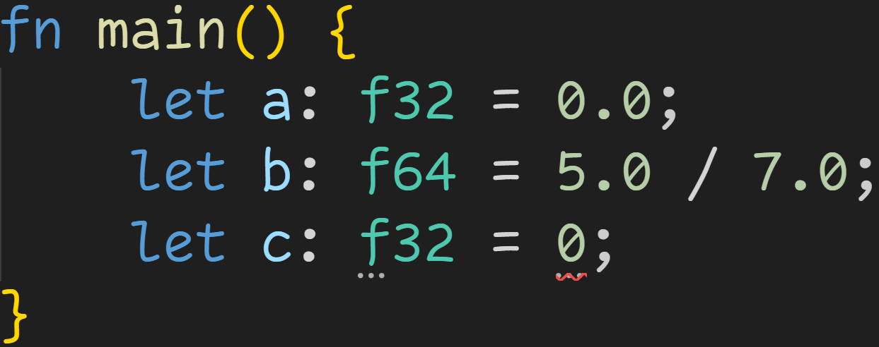
Intermission - Floating Point

Slide 115
Intermission - Floating Point
Float literals always include a dot

Slide 116
Intermission - Floating Point
This is an integer literal → Can‘t assign integers to float

Slide 117
Functions
Not all functions return values, some just do stuff with the inputs
It might just write to a file, or print something in the console

Slide 118
Functions
Not all functions return values, some just do stuff with the inputs
It might just write to a file, or print something in the console
The return type is optional, and declared using the Arrow syntax

Slide 119
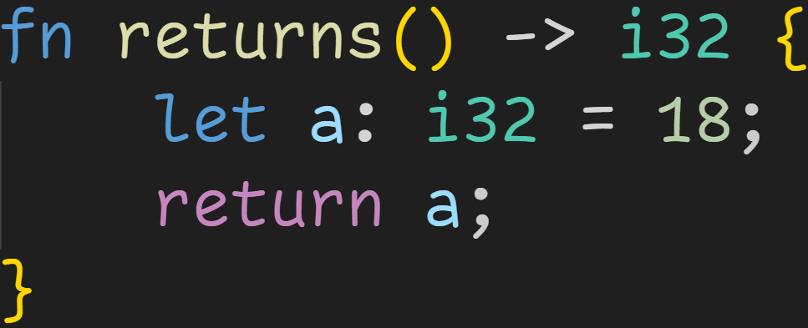
Functions
The return type is optional, and declared using the Arrow syntax

Slide 120
Functions
The return type is optional, and declared using the Arrow syntax
Arrow Syntax

Slide 121
Functions
The return type is optional, and declared using the Arrow syntax
This function returns a value of type i32

Slide 122
Functions
The return type is optional, and declared using the Arrow syntax
All return statements must return a value of the specified type

Slide 123
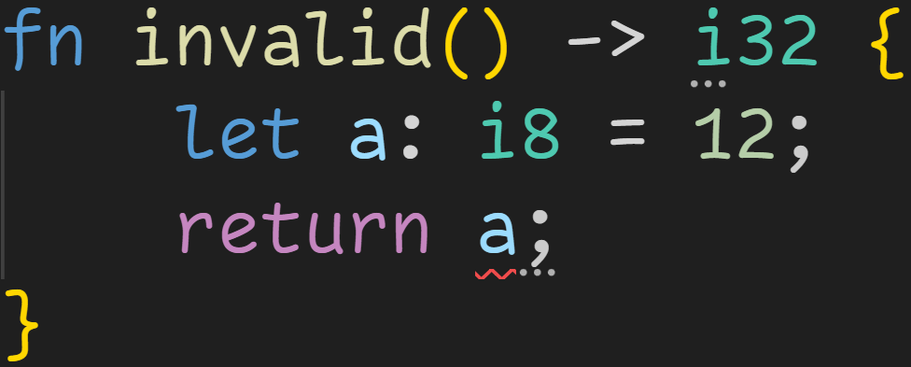
Functions

Slide 124
Functions
returns a value of type i8 → i8 is not i32 → Compiler error

Slide 125
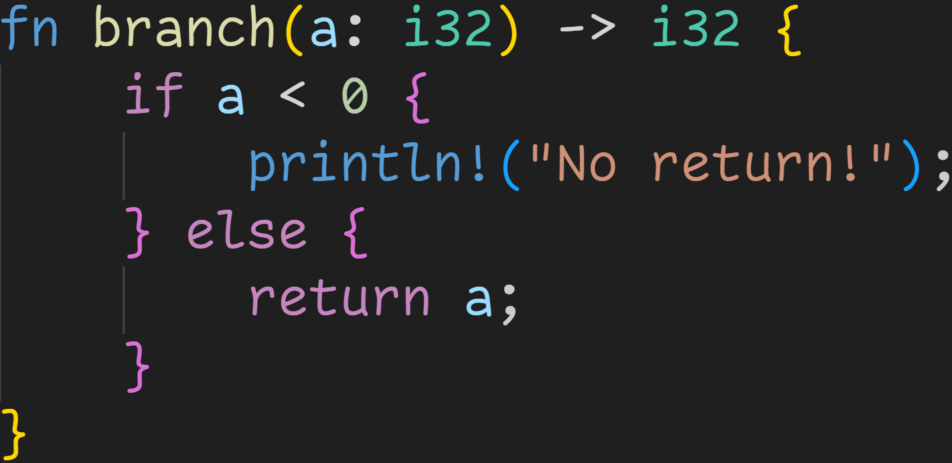
Functions

Slide 126
Functions
If a function is declared to return something, every possible control flow path must end with a return statement

Slide 127
Functions
This branch does not return a value, not even after the if-block
If a function is declared to return something, every possible control flow path must end with a return statement

Slide 128
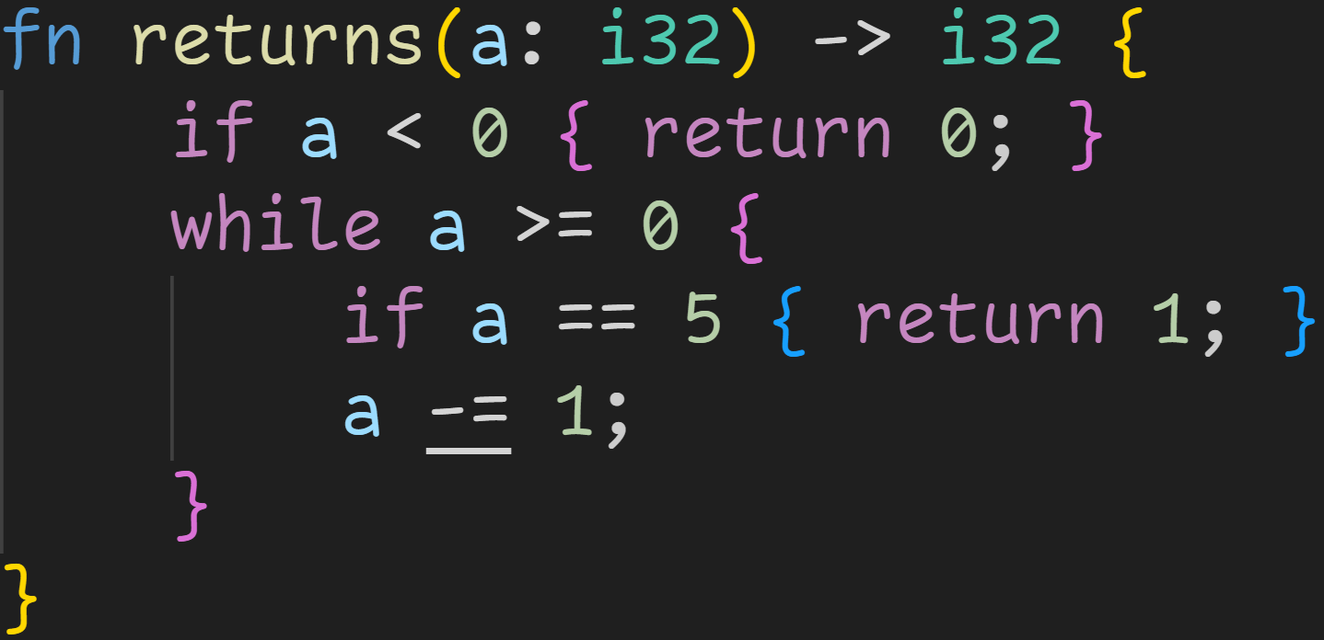
Functions
1/3

Slide 129
Functions
1/3
Do all possible paths lead to a return?

Slide 130
Functions
1/3
Do all possible paths lead to a return?
Nope. Imagine a was 4 in the beginning :^)
We get to the end of the function, but there is no return statement there!

Slide 131
Functions
1/3
Code wouldn‘t compile anyway, a is not mutable :^)

Slide 132
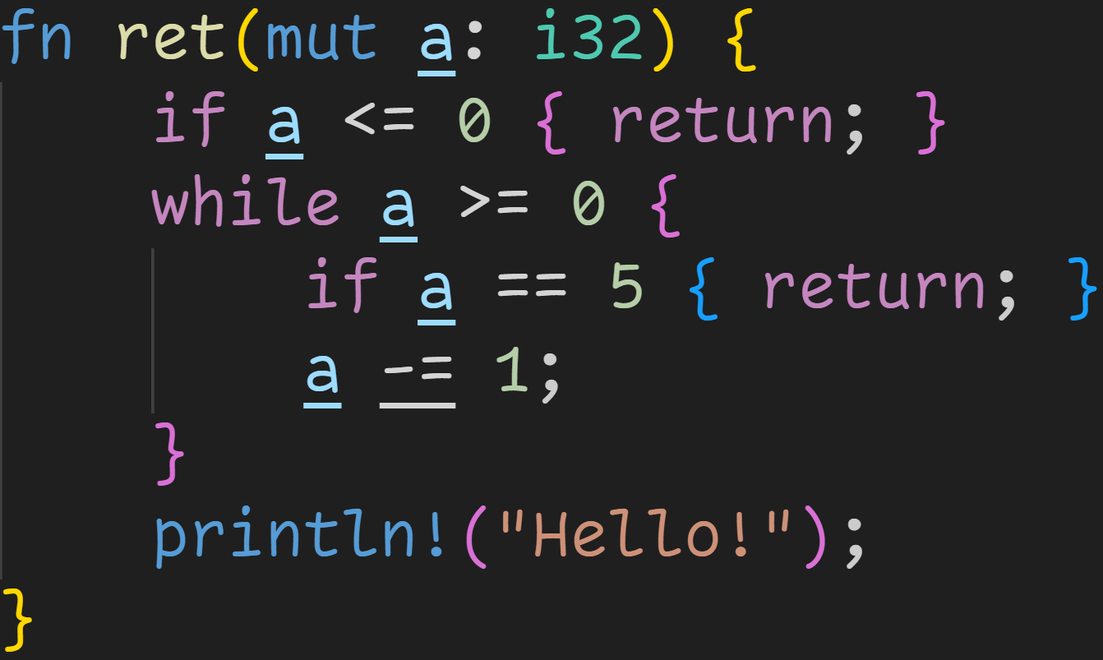
Functions

Slide 133
Functions
We don‘t return anything

Slide 134
Functions
Now we simply return – without a value

Slide 135
Functions
There‘s an implicit return at the end of every function, not every control flow path needs to end in a return

Slide 136
Intermission - Exercises
Time for exercises!

Slide 137
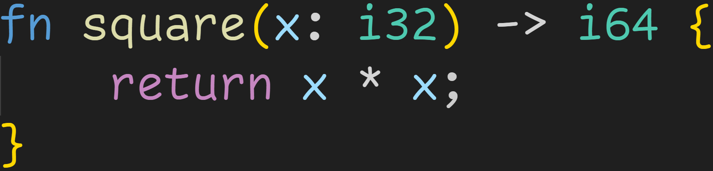
Intermission - Exercises
1/3

Slide 138
Intermission - Exercises
Is this a valid function definition?
1/3

Slide 139
Intermission - Exercises
Is this a valid function definition?
1/3
Expected return type: i64

Slide 140
Intermission - Exercises
Is this a valid function definition?
1/3
Expected return type: i64
Actual: i32 * i32 = i32

Slide 141
Intermission - Exercises
Is this a valid function definition?
1/3
Expected return type: i64
Actual: i32 * i32 = i32
Rust does not perform type casts for us, this code does not compile

Slide 142
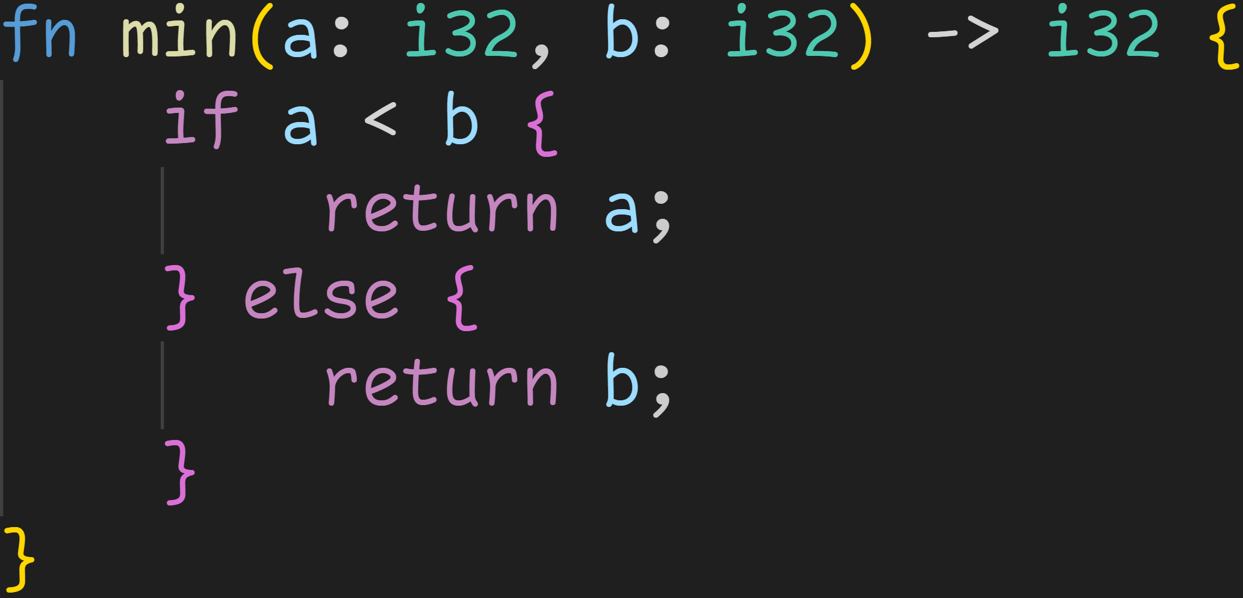
Intermission - Exercises
1/3

Slide 143
Intermission - Exercises
Is this a valid function definition?
1/3

Slide 144
Intermission - Exercises
Is this a valid function definition?
1/3
Yep!
→ All return statements return i32 → All possible paths lead to a return

Slide 145
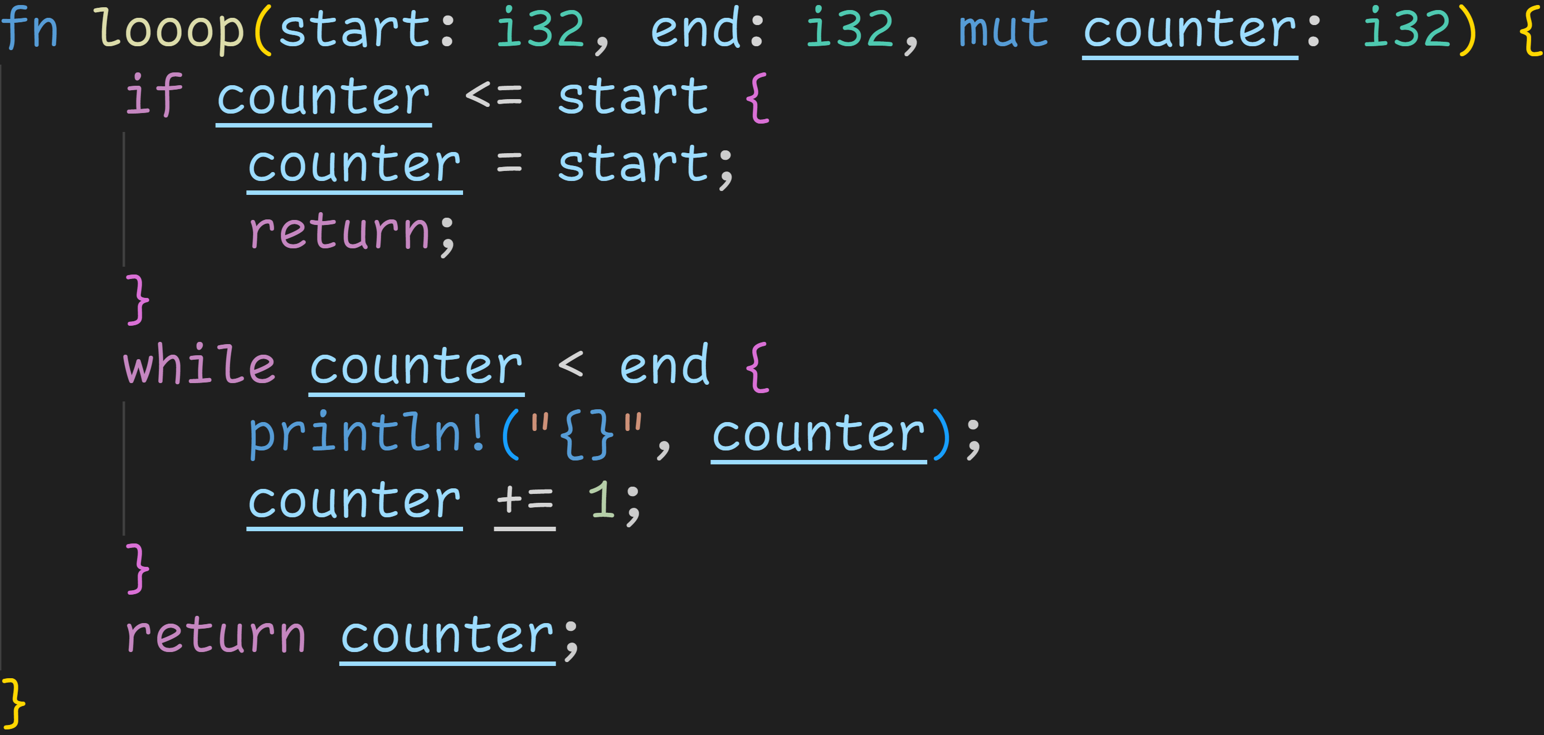
Intermission - Exercises
2/3

Slide 146
Intermission - Exercises
Is this a valid function definition?
2/3

Slide 147
Intermission - Exercises
Is this a valid function definition?
2/3
Function not declared to return anything

Slide 148
Intermission - Exercises
Is this a valid function definition?
2/3
Function not declared to return anything
Yet, we‘re attempting to return i32. → Not a valid function

Slide 149
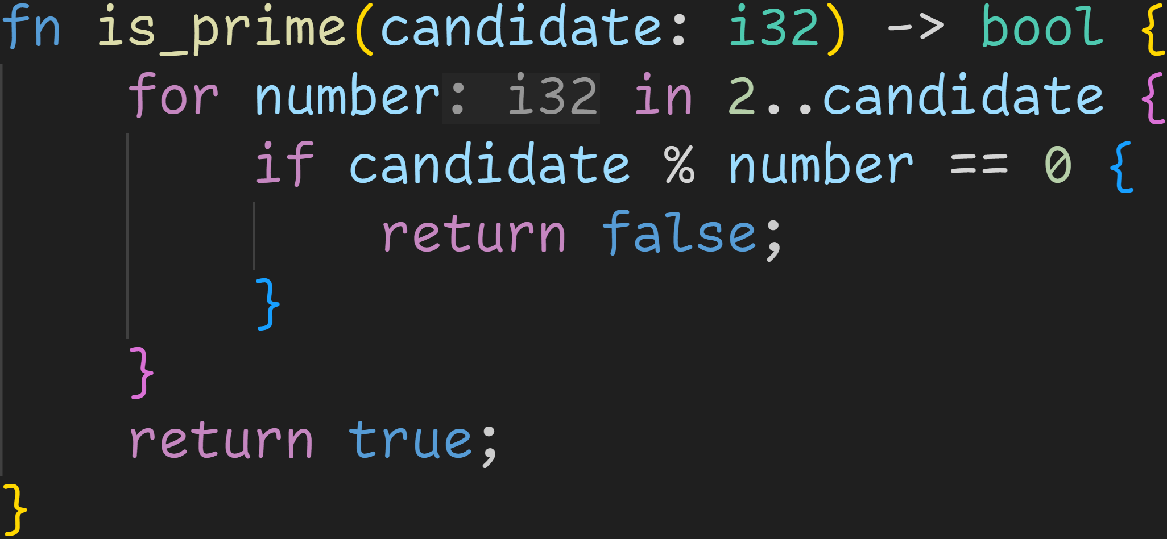
Intermission - Exercises
3/3

Slide 150
Intermission - Exercises
Is this function correct?
3/3

Slide 151
Intermission - Exercises
Is this function correct?
3/3
The algorithm itself is correct, it correctly tells us if a given number is prime or not.

Slide 152
Intermission - Exercises
Is this function correct?
3/3
The algorithm itself is correct, it correctly tells us if a given number is prime or not.
BUT: It returns true for negative numbers, 0 and 1! :^) Those are not prime numbers :(

Slide 153
Intermission - Exercises
3/3
The algorithm itself is correct, it correctly tells us if a given number is prime or not.
BUT: It returns true for negative numbers, 0 and 1! :^) Those are not prime numbers :(
How do we fix that?

Slide 154

Intermission - Exercises
Step 1: Prevent negative numbers!
3/3

Slide 155
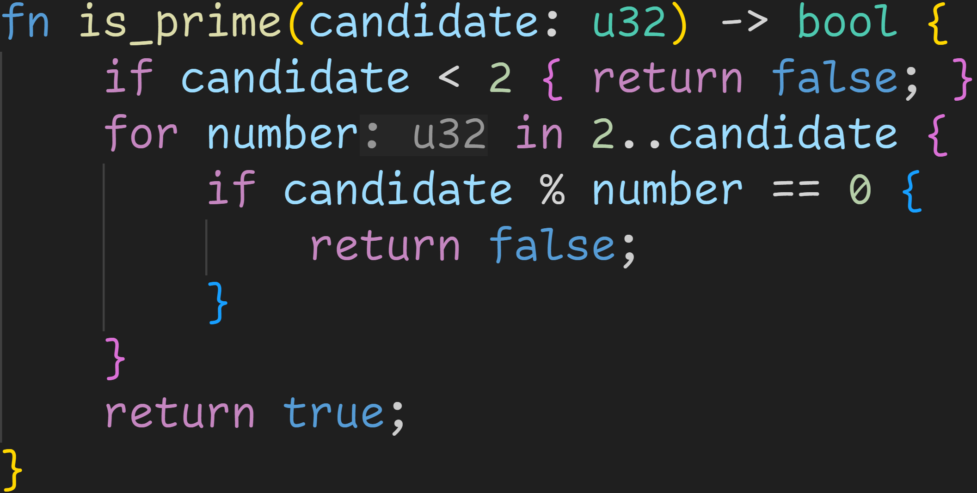
Intermission - Exercises
3/3
Step 2: 0 and 1 are not prime

Slide 156
Intermission - Exercises
3/3
Is this now a correct function?

Slide 157
Intermission - Exercises
3/3
Is this now a correct function?
Yes :)

Slide 158
Next time
Using functions

